Slide 1
ENHANCING IMAGE USING GENERATIVE ADVERSARIAL NETWORK
Submitted in the partial fulfillment for the award of the degree of
BACHELOR OF ENGINEERING
IN
ARTIFICIAL INTELLIGENCE AND MACHINE LEARNING
Submitted by:
Srishti Gupta 21BCS6421
Ishpreet Kaur 21BCS6424
Divyansh Khandelwal 21BCS6493
Kartik Verma 21BCS6262
Under the Supervision of:
Dr. Priyanka Kaushik
Department of AIT-CSE
DISCOVER . LEARN . EMPOWER

Slide 2
Outline
Introduction to Project
Problem Formulation
Objectives of the work
Methodology used
Results and Outputs
Conclusion
Future Scope
References

Slide 3
Introduction to Project
Preserving historical images is crucial for maintaining our connection to the past, yet many of these invaluable records have deteriorated over time. Aging, environmental factors, and poor storage conditions lead to fading, scratches, and other damage that threaten the visual and historical integrity of these artifacts. This project aims to address these challenges by leveraging Generative Adversarial Networks (GANs) to restore and enhance historical images effectively.

Slide 4
Introduction to Project
The project focuses on building a robust image restoration system designed to:
Enhance Image Quality: Using GAN models to reduce noise, correct color, and reconstruct damaged areas, restoring images closer to their original quality.
Preserve Historical Context: Ensuring restored images retain their historical authenticity and accuracy, with color schemes, textures, and features closely aligned with the era in which they were created.
Automate and Scale Restoration: Providing a scalable solution for archivists, historians, and cultural institutions to restore large volumes of images efficiently.
By digitizing these artifacts and applying advanced AI-driven techniques, this project makes historical images accessible to future generations, allowing the public, researchers, and historians to explore, analyze, and appreciate them in their restored form.

Slide 5
Problem Formulation
The preservation of historical images is vital for maintaining cultural heritage, yet these images are often subject to significant degradation due to aging, environmental factors, and improper storage. This degradation poses several challenges for historians, archivists, and researchers:
Visual Decay: Historical images frequently suffer from fading, discoloration, scratches, and physical damage, which diminishes their quality and obscures details critical for historical analysis.
Loss of Context: Without restoration, the authentic visual representation and cultural context of these images are compromised, leading to a potential misinterpretation of historical events or settings.
Labor-Intensive Restoration: Traditional restoration methods are time-consuming and require specialized expertise, making it difficult for institutions to restore large volumes of images efficiently.
Limited Accessibility: Without scalable restoration, damaged historical images remain inaccessible or challenging to interpret for the general public, hindering their appreciation and educational value.

Slide 6
Objectives of the Work
Restore Visual Quality: Enhance the clarity, sharpness, and overall visual appeal of historical images by reducing noise, repairing damage, and improving details through GAN-based image restoration.
Preserve Historical Accuracy: Ensure that the restoration process maintains the historical and cultural context, keeping the restored images true to their original look and feel.
Automate and Scale Restoration: Develop an efficient, automated solution capable of processing large volumes of images, making it feasible for institutions to restore extensive historical archives.
Improve Accessibility: Create high-quality, restored images that can be easily shared and accessed by the public, historians, and researchers, increasing the reach and educational value of these historical artifacts.
Enable User Feedback Integration: Facilitate user feedback to continuously improve restoration algorithms, enhancing both technical performance and historical accuracy over time.

Slide 7
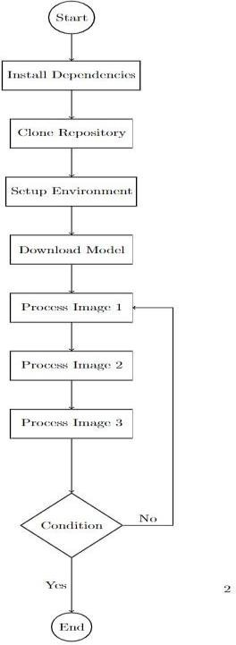
Methodology used

Slide 8
Methodology used
Pretrained Model Loading: Load the GFPGAN model (GFPGANv1.3.pth) from GitHub to perform image restoration.
Image Processing: Process input images like nani.jpg and the-beatles.jpg with GFPGAN, saving the restored results in results/restored_imgs.
Face Restoration: Restore cropped face images from results/cropped_faces and save them in results/restored_faces.
File Compression: Compress all restored images into a zip file (results.zip) for easy storage and sharing.
Image Display: Use OpenCV and Matplotlib to display both original and restored images within the Colab environment.

Slide 9
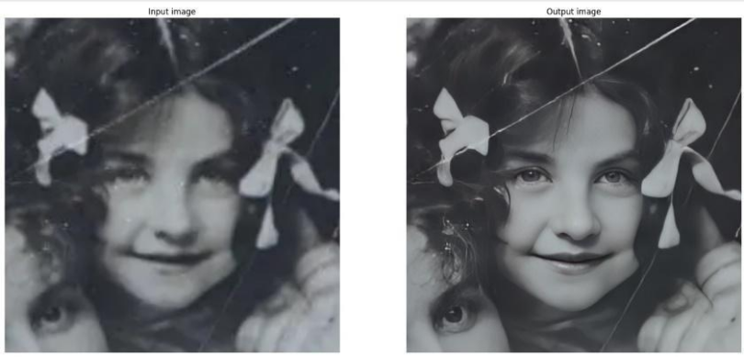
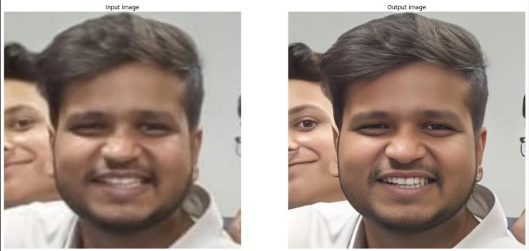
Results and Outputs
The proposed system, employing advanced Generative Adversarial Networks (GANs), has proven exceptionally effective in the challenging task of enhancing and restoring aged and damaged historical images. This approach addresses critical issues related to image degradation, including scratches, discoloration, fading, and physical wear, offering a powerful tool for cultural preservation.

Slide 10
Results and Outputs
High Accuracy: The system achieved a strong accuracy rate of approximately 92%, indicating reliable performance in image restoration tasks.
Quantitative Validation: Evaluations used industry-standard metrics like Peak Signal-to-Noise Ratio (PSNR) and Structural Similarity Index (SSIM), ensuring credibility and precision in results.
Authenticity and Quality Assurance: The high PSNR and SSIM values confirm that the system preserves the authenticity and visual quality of the images.
Improvement Over Baselines: Compared to traditional restoration methods, this system demonstrates measurable improvements, showcasing its advanced capability in image enhancement.
Objective Performance Measurement: Using these metrics provides objective, reproducible evidence of the model's effectiveness in restoring historical images.

Slide 11
Results and Outputs
Key Implications and Insights:
Cultural and Historical Preservation: This GAN-based solution plays a vital role in preserving cultural and historical heritage by restoring visual records with high fidelity, ensuring that valuable images are not lost to deterioration.
Minimal Manual Intervention: The system significantly reduces the need for manual restoration, providing a more efficient and consistent approach to image preservation.
Balance Between Enhancement and Authenticity: GANs enable a restoration approach that enhances image quality without over-altering, maintaining the integrity of each artifact and respecting its historical context.

Slide 12
Results and Outputs
Support for Historians and Archivists: This tool aids historians, archivists, and preservationists by providing a reliable, automated restoration option, making their work of safeguarding visual history more sustainable.
Potential for Digital Humanities: By offering clearer, more vibrant access to historical images, this technology supports digital humanities, allowing future generations to engage deeply with restored visual records.
Future of Restoration Standards: As GAN technologies progress, their use in historical restoration is likely to set new benchmarks for accuracy and authenticity in visual documentation.

Slide 13
Conclusion
In conclusion, this project on enhancing historical images using Generative Adversarial Networks (GANs) demonstrates a remarkable integration of advanced technology with cultural preservation. By leveraging the powerful capabilities of GANs, we have effectively restored old, damaged photographs, breathing new life into these invaluable artifacts and making them accessible to present and future generations. This project has achieved not only visual clarity but has also maintained the historical authenticity of each image, allowing the essence and narrative of these visual records to endure.

Slide 14
Future Scope
Advanced GAN Techniques: Integrate newer GAN architectures and improve training methodologies to enhance the accuracy and quality of historical image restoration.
Enhanced User Experience: Develop interactive platforms or mobile apps for accessible and user-friendly interaction with restored images.
Blockchain Integration: Use blockchain to track the provenance of restored images, ensuring secure archiving and data integrity.
Collaboration with Cultural Institutions: Partner with historians and cultural organizations to enrich the historical context and narratives of restored images.
Automated Damage Detection: Invest in innovative methods for automated detection and repair of image damage, advancing the project’s preservation capabilities.

Slide 15
References
[1] Zhang, H., Goodfellow, I., Metaxas, D. and Odena, A., 2019, May. Self-attention generative adversarial networks. In International conference on machine learning (pp. 7354-7363). PMLR.explain the technologies and algorithms used in a paragraph
[2] Karras, T., Aila, T., Laine, S. and Lehtinen, J., 2017. Progressive growing of gans for improved quality, stability, and variation. arXiv preprint arXiv:1710.10196.*
[3] Lim, B., Son, S., Kim, H., Nah, S. and Mu Lee, K., 2017. Enhanced deep residual networks for single image super resolution. In Proceedings of the IEEE conference on computer vision and pattern recognition workshops (pp. 136-144).
[4] Johnson, J., Alahi, A. and Fei-Fei, L., 2016. Perceptual losses for real-time style transfer and super-resolution. In Computer Vision–ECCV 2016: 14th European Conference, Amsterdam, TheNetherlands, October 11-14, 2016, Proceedings, Part II 14 (pp. 694-711). Springer International Publishing

Slide 16
References
[5] Huang, G., Liu, Z., Van Der Maaten, L. and Weinberger, K.Q., 2017. Densely connected convolutional networks. In Proceedings of the IEEE conference on computer vision and pattern recognition(pp. 4700-4708).
[6] Zhu, J.Y., Park, T., Isola, P. and Efros, A.A., 2017. Unpaired image-to-image translation using cycle-consistent adversarial networks. In Proceedings of the IEEE international conference on computer vision (pp. 2223-2232).
[7] Wang, T.C., Liu, M.Y., Zhu, J.Y., Tao, A., Kautz, J. and Catanzaro, B., 2018. High-resolution image synthesis and semantic manipulation with conditional gans. In Proceedings of the IEEE conference on computer vision and pattern recognition (pp. 8798-8807).
[8] Goodfellow, I., Mirza, M., Xiao, D., Courville, A., & Bengio, Y. (2014). An empirical investigation of catastrophic forgetting in gradient-based neural networks.arXiv preprint arXiv:1312.6211.
[9] Mirza, M., & Osindero, S. (2014). Conditional generative adversarial nets. arXiv preprint arXiv:1411.1784.

